Slide 1


Healthy LIVING Pharmacy.
Notes:
I have kept the first few slides have been kept in for reference purposes only.

Slide 2


HLP Status
In July 2016, the Pharmacy and Public Health Forum developed a new process for the implementation of level 1 HLPs.
This involved a move from a commissioner-led HLP accreditation system to a profession-led self-assessment process, based on clear quality criteria and underpinned by a proportionate quality assurance process (led by the Royal Society for Public Health (RSPH)).
Government impose New contract and announces as part of the quality criterion - points have been awarded for achieving HLP status level 1. – compliance will be checked.
Notes:
Reference only

Slide 3
Domain | Criteria | Number of review points at which it can be claimed | Points at any one review point
Patient Safety | Production of a written report that demonstrates evidence of analysis, learning and action taken in response to near misses and patient safety incidents, including implementation of national patient safety alerts and having shared learning | One | 20
Patient Safety | 80% of registered pharmacy professionals have achieved level 2 safeguarding status for children and vulnerable adults within the last two years | Two | 5
Patient Experience | Results of patient experience survey from the last 12 months published on the pharmacy’s NHS Choices page | One | 5
Public Health | Healthy Living Pharmacy level 1 (self-assessment) | One | 20
Digital | Demonstration of having accessed the Summary Care Record and increase in access since the last review point | Two | 5
Digital | NHS111 Directory of Services entry up to date at review point | Two | 2.5
Clinical Effectiveness | Asthma patients dispensed more than 6 short acting bronchodilator inhalers without any corticosteroid inhaler within a 6-month period are referred to an appropriate health care professional for an asthma review | Two | 10
Workforce | 80% of all pharmacy staff working in patient facing roles are trained ‘Dementia Friends’ | Two | 5
Notes:
Reference only

Slide 4
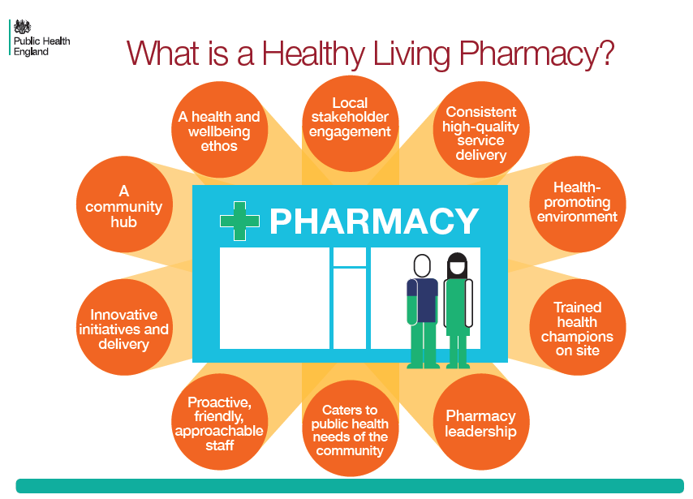
What is a HLP?
A Community pharmacy that :
Is at it’s heart delivering high quality pharmaceutical services.
Patients can seek advice on any Health related and public health issue.
Has staff that are approachable well trained and motivated to cater to the needs of their patients .
Has forward thinking leadership committed to improving it’s health.
Reaches into the local environment to improve health of it’s patients.
Notes:
Reference only

Slide 5
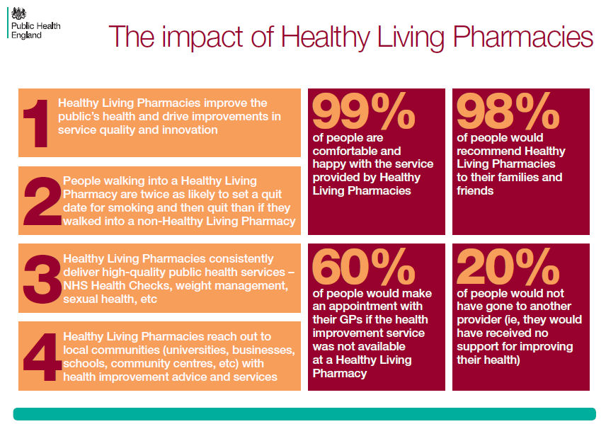
Recognised success of a HLP
More people successfully quit smoking in HLP
The number of people who accessed sexual health services and were provided with additional sexual health advice was greater.
The acceptability of community pharmacy as a location for clients to receive an alcohol service and the relatively high levels of activity seen in HLPs show that HLPs could have an important contribution to this harm reduction service.
HLPs were effective at delivering increased support for people taking medicines for long term conditions, through both Medicines Use Reviews and the New Medicine Service.
Notes:
Reference only

Slide 6

PHE New Self Assessment Process for Accreditation at Level 1
Public Health Needs - All pharmacy staff have an awareness of the local health and pharmaceutical needs.
Health and Well being Ethos – All pharmacy staff have an understanding of basic health and wellbeing and every interaction is used to promote.
Team Leadership.- A member of the team has undergone leadership training.
Communication.- The pharmacy team members are welcoming friendly and aware of privacy for different individuals seeking advice.
Community Engagement.- The pharmacy team works with other organizations and can locally signpost where needed.
Commissioner Engagement. Is aware of local commissioners and who to contact where needed.
Health Promoting Environment – Has a dedicated health promotion Zone.
Data Collection – Procedures are in place for secure emails to be routinely accessed confidentially.
Sustainability. - Contributes to a sustainable environment.
Notes:
So how do you become a HLP.
New self assessment underpinned by a quality assurance process lead by Royal society for Public Health.
9 domains which I will break down for you.

Slide 7

PUBLIC HEALTH NEEDS - What does that mean ?
Complete the relevant training from CPPE on “ Introduction to Public Health “ and keep certificate on file.
Review and keep on file relevant extracts from the PNA/ JSNA and action plan local needs that can be supported within the community.
When completing the CPPQ process build in questions which may be relevant to the local community.
Keep records of any meetings attended which support this theme.
Notes:
Complete CPPE course- in my sheet
Pharmacy needs assessment and Joint Strategic needs assessment in my sheet
Community pharmacy patient questionnaire- adapted to local needs.
Keep records of every health promotion

Slide 8

Health and well being ethos
All pharmacy staff understand the basic principles of health and wellbeing, and that every interaction is an opportunity for a health promoting intervention.
At least one member of pharmacy staff (1 Full Time Equivalent) has completed the training and assessment of the Royal Society for Public Health (RSPH) Level 2 Award in Understanding Health Improvement and is therefore a Health Champion.

Slide 9
What does that mean ?
1) Training certificates must be in evidence.
A) RSPH 2 staff certificates.
B) Introduction to public Health CPPE module.
C) Health and wellbeing training attendance certificates.
2) Minutes of staff meetings that show learnings from Health Champion must be evident.
Notes:
The health champion or champions needs to have done this course.

Slide 10
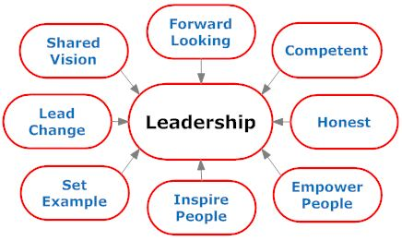
Team Leadership – What does this mean ?
An individual from the pharmacy team has undergone leadership training internally or through an organization that maps the following domains:
o Inspiring a shared purpose.
o Sharing the vision.
o Engaging the team.
o Developing capability.
o Influencing for results.
Filed :
1) Certificates of attendance/completion.
2) HLP Action plan available.
3) Written feedback on team leader is available.
Notes:
CPPE run leadership courses both e-learning and face to face events full day.
We at the LPC are working closely with both Avon LPC and Dorset LPC and depending on need can organise local training events.

Slide 11
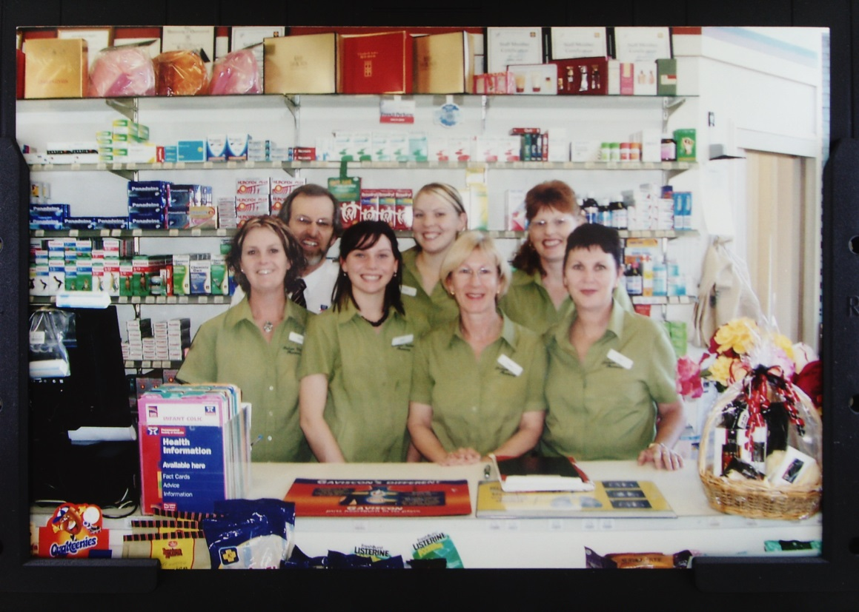
Communication
The pharmacy team is friendly, welcoming and sensitive to the need for privacy for different individuals seeking advice including respecting people’s values and beliefs.
The pharmacy team routinely explain who they are, wear a name badge and inform people about the information and/or services on offer.
All pharmacy staff are able to provide brief health and wellbeing advice (2-3 minutes) and have an awareness that the person may need additional support for behavioral change.
Notes:
Pharmacy staff are knowledgeable about the relevant health needs of the area.

Slide 12
What does this mean ?
1) Staff are able to access and provide information on relevant health issues.
2) Staff are able to signpost sensitively and effectively – records in evidence.
3) Staff have had appropriate training on dealing with difficult discussions on public Health issues – certificates of attendance available.
Notes:
CPPE consultation skills for support staff. Easy win.

Slide 13

Community Engagement
The pharmacy team actively works in collaboration with other community organizations (e.g. schools, care homes, local events, charities) to deliver pharmacy outreach and or services.
• The pharmacy team is aware of health and wellbeing resources available in the community to direct the public/patients to support groups, community exercise groups.
• The pharmacy encourages local charities and other providers to work with the pharmacy for delivery of key health messages/displays where appropriate.
• The pharmacy team is aware of appropriate health and social care providers in their community (e.g. specialist clinics, Health watch, Smoking Cessation, Drug and Alcohol Services, Health Trainer Service), or which Local Authorities could provide information about these services.
Notes:
You need to set up a signposting folder-another action plan for LPC if needed. Plus additional local feedins.

Slide 14
What does that mean ?
1) Provides services to the community and documents these events.
2) Invites Local groups / charities to work within the pharmacy.- keeps records of events undertaken.
3) The team is aware of what is available within the community and can sign post patients if needed.
All such work is photographed and documented.
Notes:
LPC want to engage with the major charities key charities to establish working pathways to enable this.
We will also use our contacts with the health and wellbeing board and public health getting better materials for pharmacy.
Clearly the micro work needs to be done locally.
Record it- historically we have been very poor at this! If we want extra services then we need to show that we can deliver.

Slide 15

Commissioner Engagement
The HLP lead is aware of the local commissioners for public health services, which may
include Local Authority, NHS England, Clinical Commissioning Group, etc.
The pharmacy team is aware of the commissioner contacts if seeking to submit bids for public health services
Lists of commissioners available.
Any correspondence filed.
Notes:
LPC will enable this by putting together list of commissioners for local health services.

Slide 16
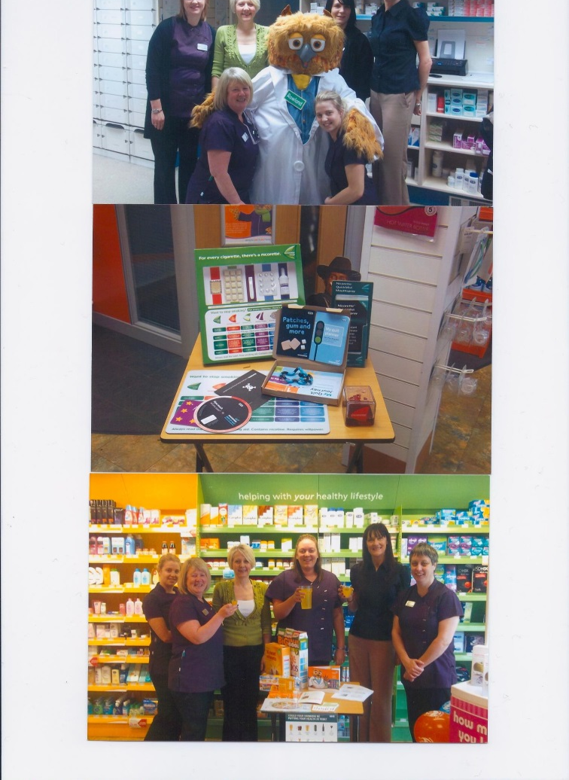
Health promotion environment
It is clear to the public that free, confidential advice on their health and wellbeing can be accessed.
• The pharmacy has a dedicated Health Promotion Zone, that:
o Is clearly marked and accessible,
o Has a professional appearance and
o Is appropriately equipped with up-to-date professional health and wellbeing information that meets the local public health needs.

Slide 17
What does this Mean ?
1) List of leaflets or promotional material used in the Health Promotion Zone.
2) Other formats for the health and wellbeing information may include: a touch-screen, plasma screen, books, DVDs, leaflets, promotional displays, demonstration models, etc.
3) Annual Community Pharmacy Patient Questionnaire (CPPQ) results and actions undertaken from review.
4) Record of Health Promotion Zone being checked by a member of the pharmacy staff at least once monthly and restocked appropriately.
5) A local health and wellbeing notice board is in evidence.
Notes:
As we heard from the podcast extract- health promotion area is very important- it needs to regularly checked and kept stocked. And recorded each time!

Slide 18

Data Collection and sustainability
Procedures are in place to ensure emails are checked regularly and that they are appropriately secure. Internet access enabled for accessing locally and nationally recognized websites.
The pharmacy contributes to a sustainable environment and this is reflected in the way they operate their business (e.g. using recyclable materials)

Slide 19
What does that Mean ?
IT system is accessible in the consultation room with access to the internet.
Self-declaration of accessibility to internet (for data collection where applicable) and ability to print appropriate material.
Information governance policy available in the pharmacy.
Photographs available of activities to support recycling.
Notes:
Quick wins here

Slide 20

What next ?
Work through the sections of the PHE document in preparation for self assessment.
Set up a HLP Portfolio file.
Support materials available :
LPC website has materials available to support.-Work to be done!
PSNC has documents to support.
LPC support events and Training courses to be announced-depending on need

Slide 21
And finally......
There are two review points during the year,.
These are:
Friday 28th April 2017; and
Friday 24th November 2017

Slide 22
There are various routes by which people can become a Dementia Friend:
For organisations
watch a minimum of two short online videos via your online code (register your organisation to receive the online code); or
attend a face-to-face Dementia Friends Information Session (to request a session for your pharmacy team please email DFOrgs@alzheimers.org.uk).
For individuals
watch a short online video; or
attend a face-to-face Dementia Friends Information Session.
The Alzheimer’s Society would prefer a pharmacy to register with Dementia Friends through the ‘organisation route’; however, many pharmacy staff including locums, may already have become Dementia Friends through the ‘individual route’.

