Slide 1

Review of activity April-September 2026

Slide 2
Support roll-out of new Pharmacy Services
Meningitis B vaccination
Supporting contractors with registration and roll-out
Promoting and signposting to raise awareness
Cancer Referral Pathway Pilot
Working with local system partners to identify pilot sites and get ready for new pilot service

Slide 3
Developing existing services
Pharmacy First
Increasing referrals from General Practice and Out of Hours
Working with Urgent Treatment Centres to develop a referral process
Increasing public awareness
Turning Point
Working with partners to ensure a smooth transition
Implementing new claims platforms
Supporting contractor queries

Slide 4

Working with changing system partners
Maintaining key relationships during NHS reorganisation
Better positioning of CPS within Integrated Healthcare Networks

Slide 5
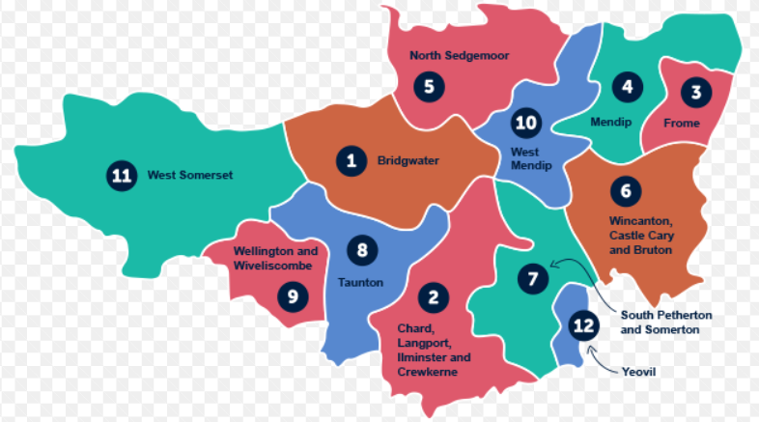
Supporting Primary Care Leads
Delivery of CPD sessions to general practice teams
Increased referral and signposting into Pharmacy services

Slide 6
Workforce development
Supporting pharmacists to become independent prescribers
Working with NHS WTE to manage the Teach and Treat programme
Supporting learners to become IPs using HUC for clinical support
Pharmacy Technicians
Supporting roll-out of the Community Pharmacy Technician Apprenticeship Programme

Slide 7
Focus for workplan
October 26-March 27

Slide 8
Key priorities
Contractor support and engagement
Provide regular, clear and timely communication.
Gather and respond to feedback to improve understanding of contractor needs and challenges.
System influence and representation
Ensure community pharmacy is effectively represented within national, regional, cluster and local healthcare planning and decision making.

Slide 9
Key priorities
Service development & delivery
Maximise uptake, quality and consistency of services.
Continued roll-out of cancer referral system.
Support development of new prescribing services.
Partnerships
Strengthen partnership working with new ICB place and cluster teams.
Continue to lead, develop and manage local Integrated Health Care Leads

Slide 10
Any questions?

